Slide 1

OPERATING SYSTEMS
Scheduling Algorithms
Venkatesh Prasad
Department of Computer Science

Slide 2

OPERATING SYSTEMS
Slides Credits for all PPTs of this course
The slides/diagrams in this course are an adaptation, combination, and enhancement of material from the following resources and persons:
Slides of Operating System Concepts, Abraham Silberschatz, Peter Baer Galvin, Greg Gagne - 9th edition 2013 and some slides from 10th edition 2018
Some conceptual text and diagram from Operating Systems - Internals and Design Principles, William Stallings, 9th edition 2018
Some presentation transcripts from A. Frank – P. Weisberg
Some conceptual text from Operating Systems: Three Easy Pieces, Remzi Arpaci-Dusseau, Andrea Arpaci Dusseau

Slide 3
Operating systems
SJF, SRTF, Priority and RR Scheduling
Venkatesh Prasad
Department of Computer Science

Slide 4
OPERATING SYSTEMS
Shortest-Job-First (SJF) Scheduling
Associate with each process the length of its next CPU burst
Use these lengths to schedule the process with the shortest time
SJF is optimal – gives minimum average waiting time for a given set of processes
The difficulty is knowing the length of the next CPU request
Could ask the user

Slide 5
OPERATING SYSTEMS
Example of SJF Scheduling
ProcessArriva l Time Burst Time
P₁ 0.0 6
P₂ 2.0 8
P₃ 4.0 7
P₄ 5.0 3
SJF scheduling chart
Average waiting time = (3 + 16 + 9 + 0) / 4 = 7
Note: If using FCFS scheduling, average waiting time = (0 + 6 + 14 + 21) / 4 = 10.25 ms.

Slide 6
OPERATING SYSTEMS
Determining Length of Next CPU Burst
Can only estimate the length – should be similar to the previous one
Then pick process with shortest predicted next CPU burst
Can be done by using the length of previous CPU bursts, using exponential averaging
Commonly, α set to ½
Preemptive version called shortest-remaining-time-first

Slide 7
OPERATING SYSTEMS
Prediction of the Length of the Next CPU Burst

Slide 8
OPERATING SYSTEMS
Examples of Exponential Averaging
α =0
τ_{n+1} = τ_{n}
Recent history does not count
α =1
τ_{n+1} = α t_{n}
Only the actual last CPU burst counts
If we expand the formula, we get:
τ_{n+1} = α t_{n}+(1 - α)α t_{n} ₋₁ + …
+(1 - α )^{j} α t_{n} _{-j} + …
+(1 - α )^{n +1} τ₀
Since both α and (1 - α) are less than or equal to 1, each successive term has less weight than its predecessor

Slide 9
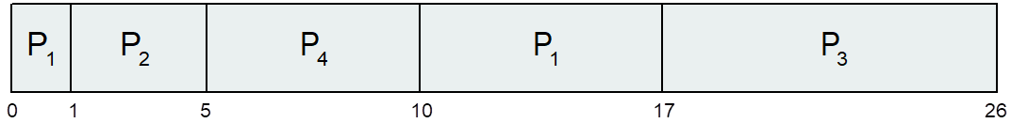
OPERATING SYSTEMS
Example of Shortest-remaining-time-first
Preemptive SJF Scheduling is sometimes called SRTF
Now we add the concepts of varying arrival times and preemption to the analysis
ProcessA arri Arrival TimeT Burst Time
P₁ 0 8
P₂ 1 4
P₃ 2 9
P₄ 3 5
Preemptive SJF Gantt Chart
Average waiting time = [(10-1)+(1-1)+(17-2)+5-3)]/4 = 26/4 = 6.5 msec

Slide 10
OPERATING SYSTEMS
Priority Scheduling
A priority number (integer) is associated with each process
The CPU is allocated to the process with the highest priority (smallest integer ≡ highest priority)
Preemptive
Nonpreemptive
SJF is priority scheduling where priority is the inverse of predicted next CPU burst time
Problem ≡ Starvation – low priority processes may never execute
Solution ≡ Aging – as time progresses increase the priority of the process

Slide 11
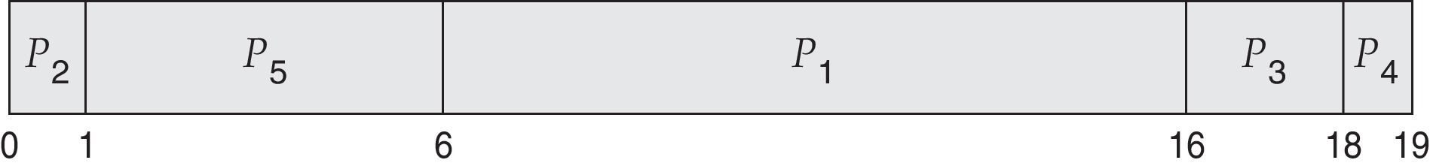
OPERATING SYSTEMS
Example of Priority Scheduling
ProcessA arri Burst TimeT Priority
P₁ 10 3
P₂ 1 1
P₃ 2 4
P₄ 1 5
P₅ 5 2
Priority Scheduling Gantt chart
Average waiting time = (6 + 0 + 16 + 18 + 1) / 5 = 41/5 = 8.2

Slide 12
OPERATING SYSTEMS
Round Robin (RR)
Each process gets a small unit of CPU time (time quantum q), usually 10-100 milliseconds. After this time has elapsed, the process is preempted and added to the end of the ready queue.
If there are n processes in the ready queue and the time quantum is q, then each process gets 1/n of the CPU time in chunks of at most q time units at once. No process waits more than (n-1)q time units.
Timer interrupts every quantum to schedule next process
Performance
q large ⇒ FIFO
q small ⇒ q must be large with respect to context switch, otherwise overhead is too high

Slide 13
OPERATING SYSTEMS
Example of RR with Time Quantum = 4
Process Burst Time
P₁ 24
P₂ 3
P₃ 3
The Gantt chart is:
Typically, higher average turnaround than SJF, but better response
q should be large compared to context switch time
q usually 10ms to 100ms, context switch < 10 usec
Notes:
RR optimizes Response time but bad for Turnaround time
SJF & SJCF optimizes Turnaround time but bad for Response time

Slide 14
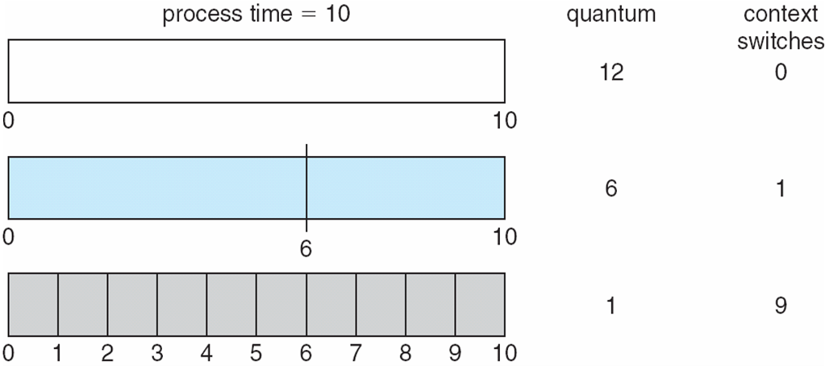
OPERATING SYSTEMS
Time Quantum and Context Switch Time

Slide 15
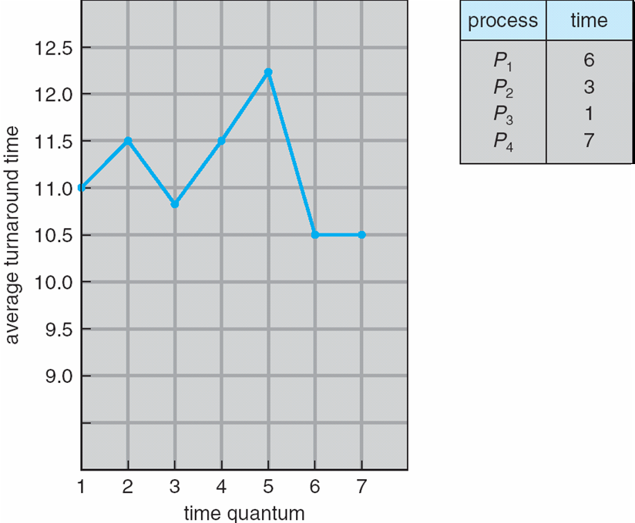
OPERATING SYSTEMS
Turnaround Time Varies With The Time Quantum
80% of CPU bursts
should be shorter than the time quantum
Notes:
The time quantum should not be too large as RR degenerates to an FCFS policy.

Slide 16
THANK YOU
Venkatesh Prasad
Department of Computer Science Engineering
venkateshprasad@pes.edu

